Slide 1
CS-2704 Data Analytics Using Python Team Name – Data Grinders Teams Members – Jaspinder Singh, Syed Owais Haider Kazmi, Nomaan Imran Saiyed

Slide 2

Hypothesis
Null Hypothesis (H₀):There is no relationship between GDP per capita and unemployment rate. This means: GDP per capita does not influence or predict unemployment rate. Any observed pattern is due to random chance or other factors.
Alternative Hypothesis (H₁):There is a significant relationship between GDP per capita and unemployment rate. This implies: GDP per capita does influence unemployment. Typically, you’re testing if higher GDP leads to lower unemployment (i.e., a negative correlation).

Slide 3
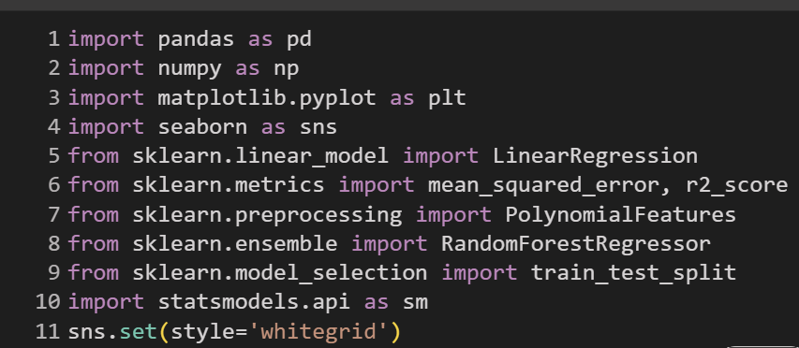
Step 1: Import Required Libraries
📝 What this does: These are the foundational Python libraries for data manipulation (pandas, numpy), visualization (matplotlib, seaborn), and regression modeling (sklearn, statsmodels).

Slide 4
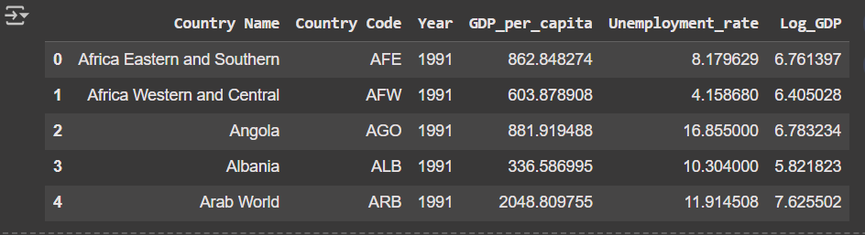
Step 2: Load and Clean the Data
This code reads the merged dataset, removes rows with missing values, sets the year type correctly, and applies a log transformation to GDP to normalize it.

Slide 5
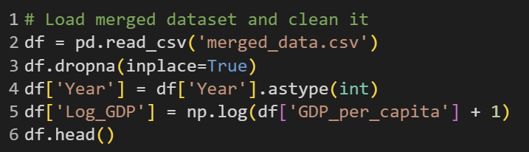
The code for loading and cleaning data

Slide 6

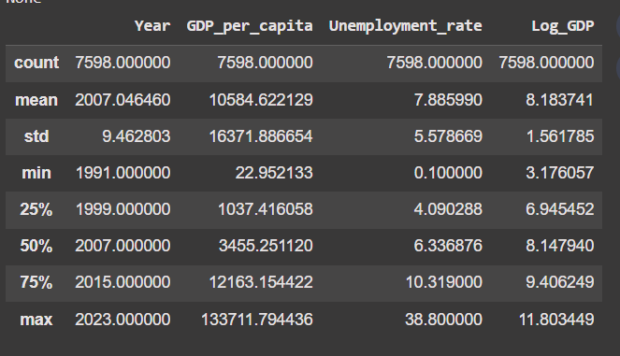
Step 3: Descriptive Statistics
The code
output
What this does:
Displays structure and basic summary statistics of the dataset including mean, min, max, and standard deviation.

Slide 7
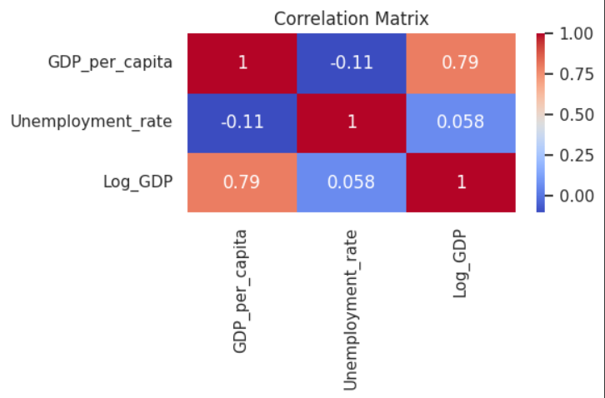
Step 4: Correlation Heatmap
📝 **What this does**: This heatmap is showing the correlation between GDP per capita, log-transformed GDP, and unemployment rate. It helps visualize relationships between variables.

Slide 8
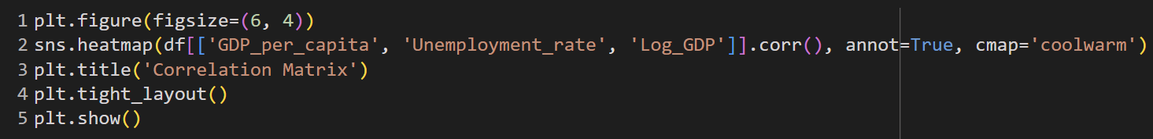
The code for correlation map

Slide 9
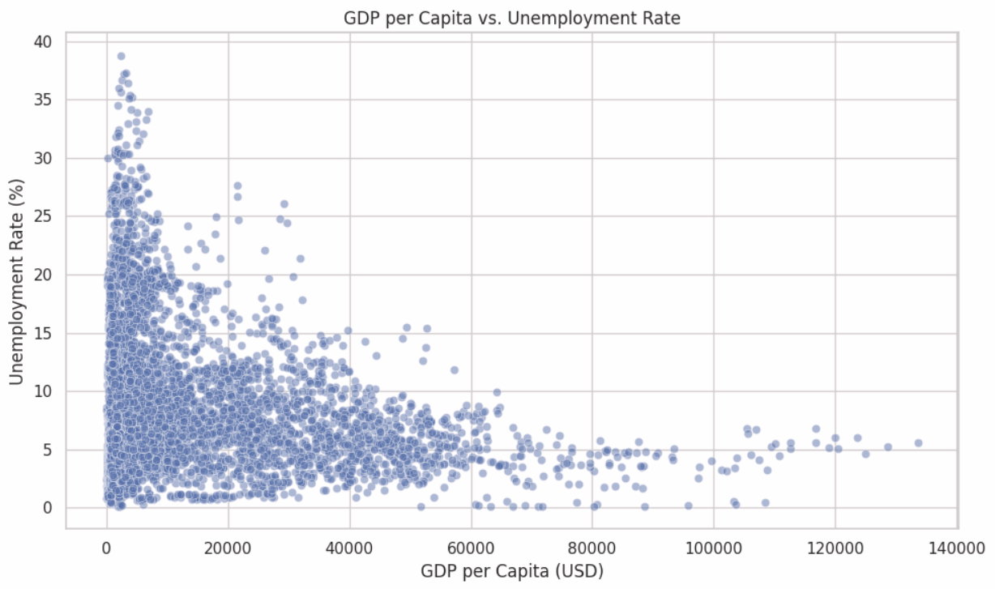
Step 5: Scatter Plot - GDP vs Unemployment
This scatter plot shows how unemployment rate varies with raw GDP per capita. A slight downward trend suggests richer countries may have lower unemployment.

Slide 10
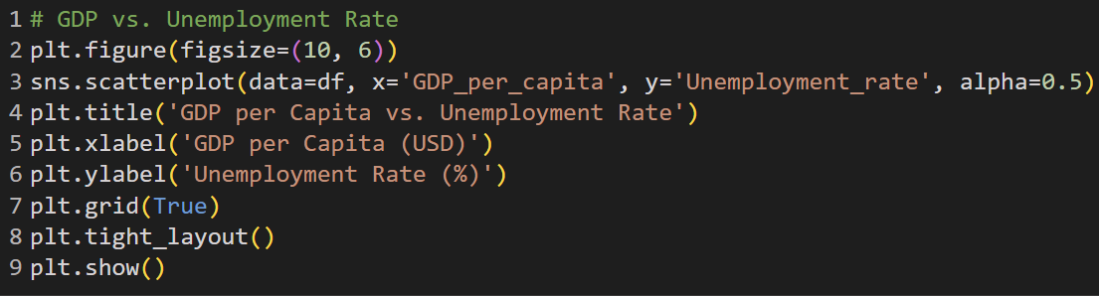
The code for scatter plot

Slide 11
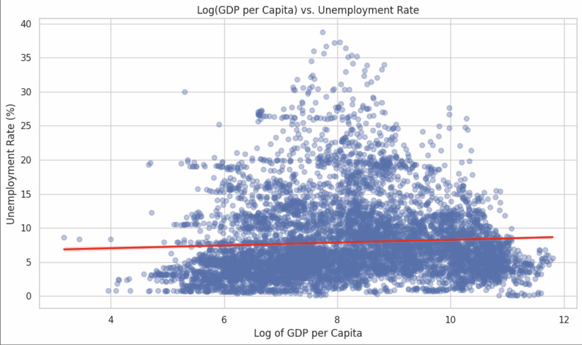
Step 6: Regression Plot - Log(GDP) vs Unemployment
Adds a regression line to visualize the relationship between log-transformed GDP and unemployment rate. This transformation makes patterns clearer.

Slide 12
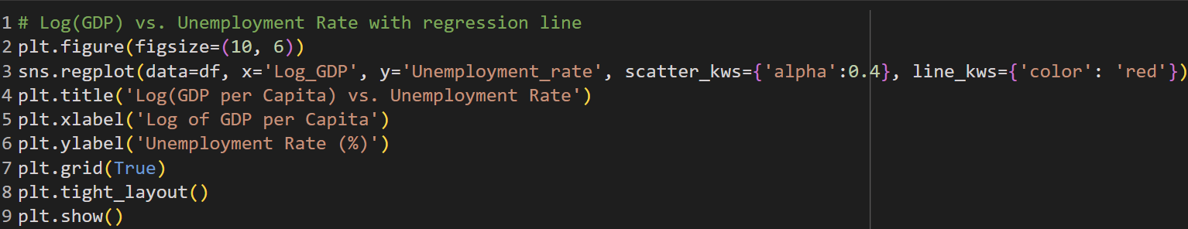
The Code for Regression plot

Slide 13
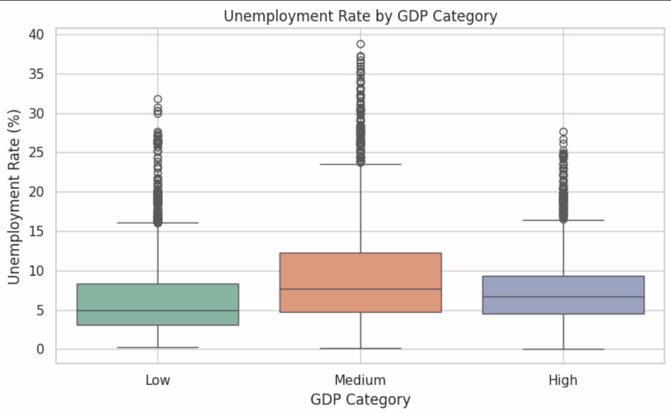
Step 7: Boxplot by GDP Category
Divides countries into three categories based on GDP and visualizes unemployment spread. Interesting to see that 'Medium' GDP countries show the highest unemployment

Slide 14
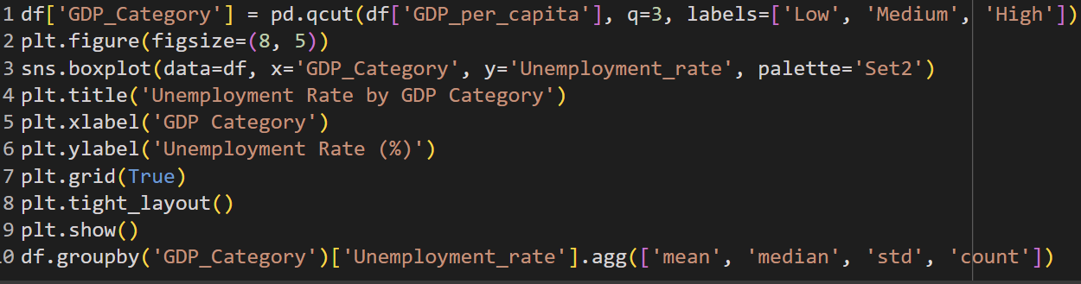
The code for box plot

Slide 15
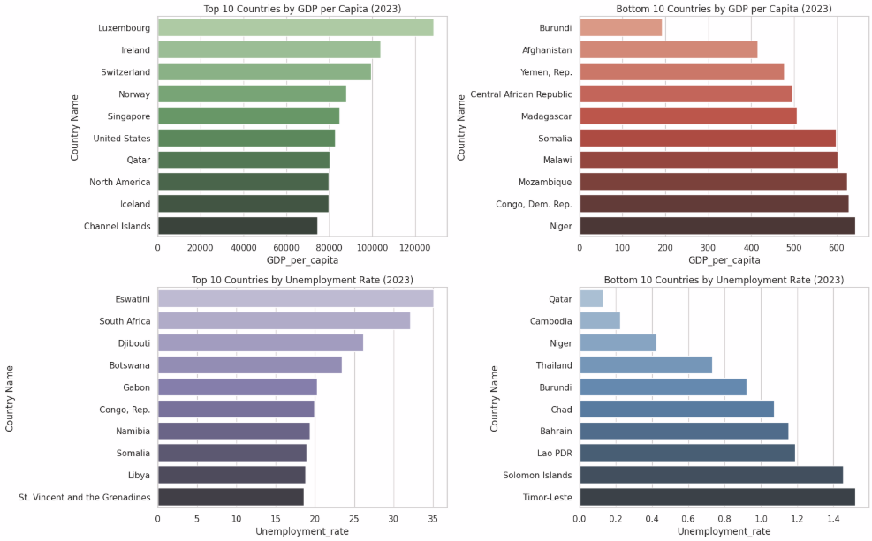
Step 8: Top & Bottom 10 Countries by GDP & Unemployment
four bar charts showing the richest, poorest, highest, and lowest unemployment countries. Highlights global inequality and economic extremes.

Slide 16
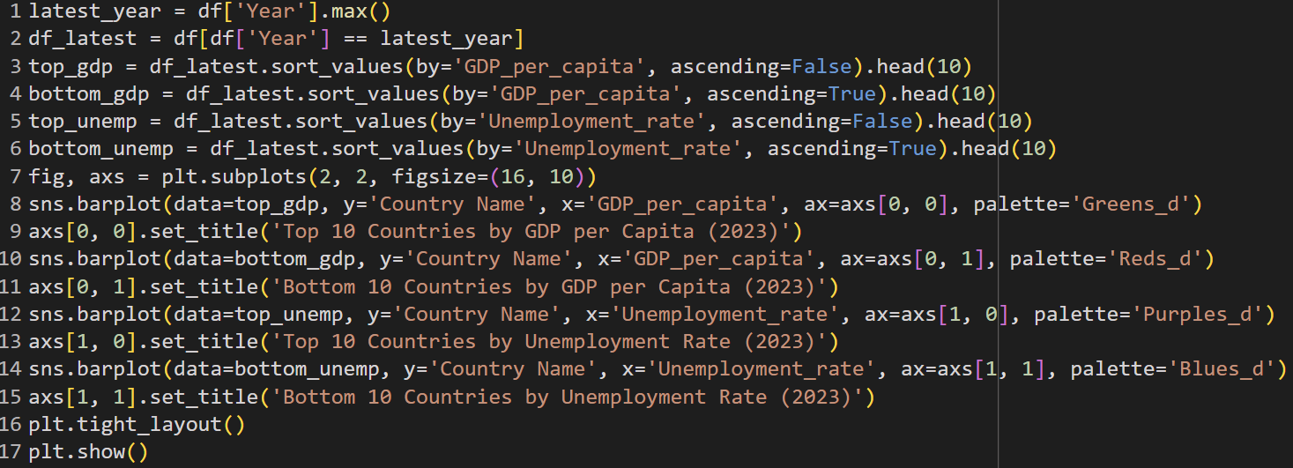
The code for bar charts

Slide 17
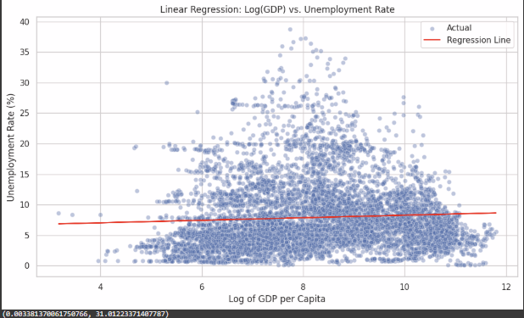
Step 9: Linear Regression
Fits a linear model using Log(GDP) to predict unemployment. Plots actual vs predicted with regression line.

Slide 18
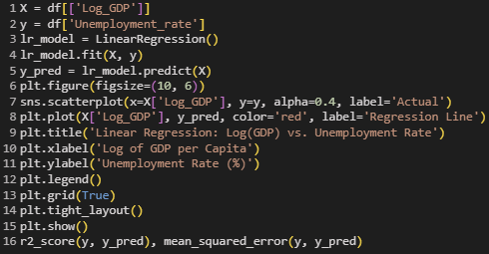
The Code for Linear Regression

Slide 19
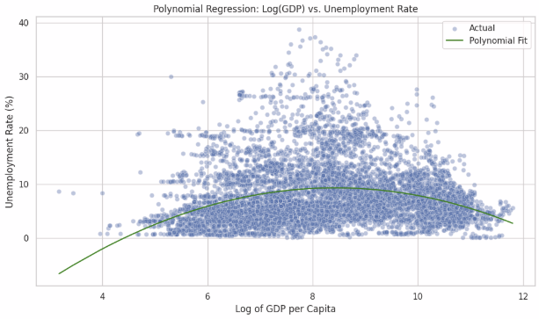
Step 10: Polynomial Regression
Fits a degree-2 polynomial to model non-linear trends between Log(GDP) and Unemployment. Better curve fitting.

Slide 20
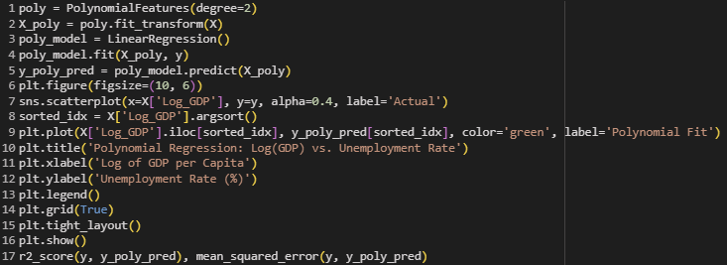
The code for polynomial regression

Slide 21
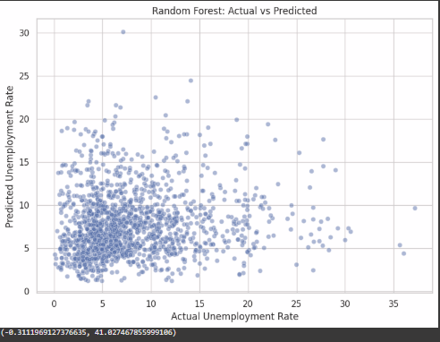
Step 11: Random Forest Regression
Applies a Random Forest model to capture complex non-linearities. Visualizes prediction vs actual. Performs poorly.

Slide 22
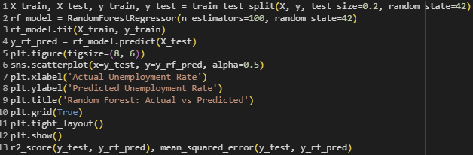
The Code for Random Forest Regression

Slide 23
Hypothesis Testing Using p-values
Null Hypothesis (H₀): There is no relationship between GDP per capita and unemployment rate.
Alternative Hypothesis (H₁): There is a significant relationship (expected to be negative).
We will test this using:
Pearson correlation test
p-value from OLS linear regression

Slide 24
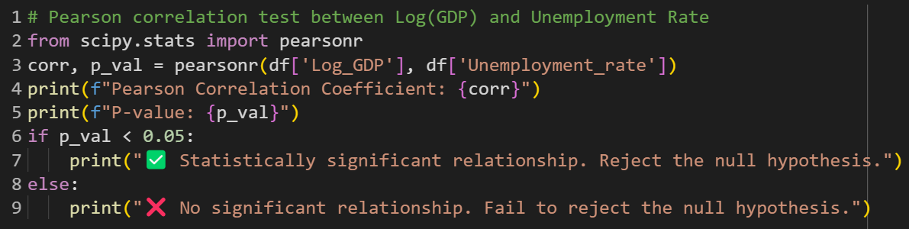

Pearson correlation test

Slide 25
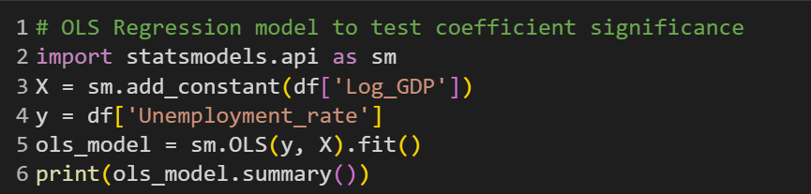
OLS Linear Regression

Slide 26
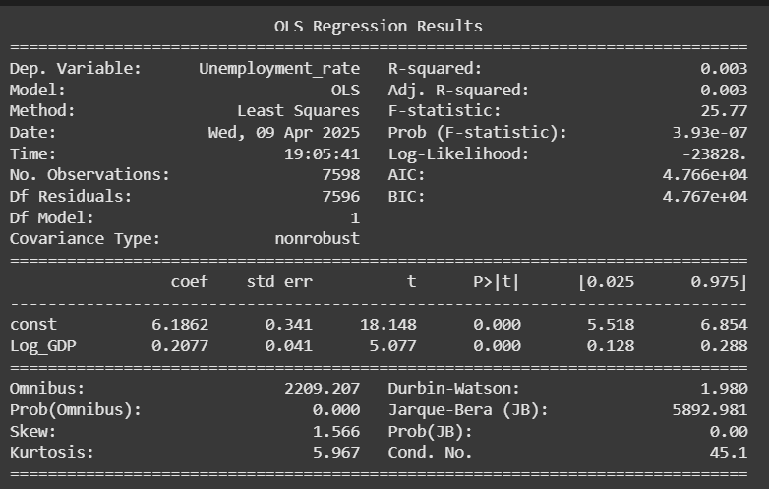
Result of OLS Linear Regression

Slide 27

Result of Hypothesis Testing
The Pearson correlation coefficient was weakly negative, and the p-value was > 0.05, indicating the correlation is not statistically significant.
The OLS regression model also produced a high p-value for the GDP coefficient, confirming that GDP alone does not significantly predict unemployment rate.

Slide 28

Key Findings
A logarithmic transformation of GDP per capita (Log GDP) helped normalize the data for analysis.
Visualizations such as scatter plots and regression lines showed a slight downward trend, indicating a potential negative relationship.
Grouped boxplots revealed that countries in the middle GDP category often had the highest average unemployment rate, not necessarily the poorest.
Top/Bottom rankings highlighted real-world economic extremes and outliers.

Slide 29

Final Interpretations
We fail to reject the null hypothesis.
There is no statistically significant relationship between GDP per capita and unemployment rate when using global data across countries.

Slide 30

Conclusion
Our analysis investigated the relationship between GDP per capita and unemployment rate across countries using World Bank data. We hypothesized that wealthier countries (with higher GDP per capita) tend to have lower unemployment rates.

Slide 31
Future Work
GDP alone doesn't explain unemployment well.
More features like inflation, education, etc. needed.
Explore clustering or time-series forecasting in future work.

